Slide 1

AWAAZ
Sacche Hausle ki Pehchan…
TEAM TROY

Slide 2

NGOs
CURRENT ISSUES
Where to Target?
How to Reach?

Slide 3
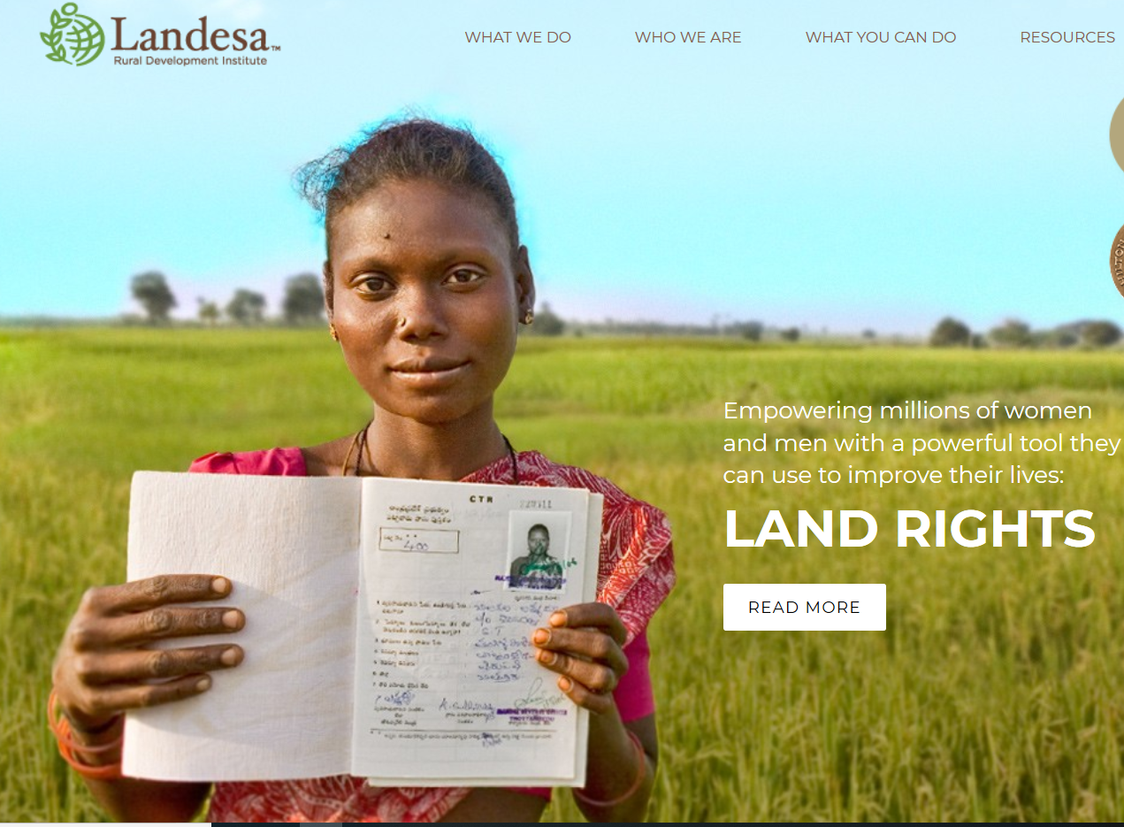
CURRENT ISSUES
US BASED NGO
HELPING HAND IN INDIA
SUCCESSFUL OUTREACH IN WEST BENGAL
EXPANSION LIMITATIONS

Slide 4
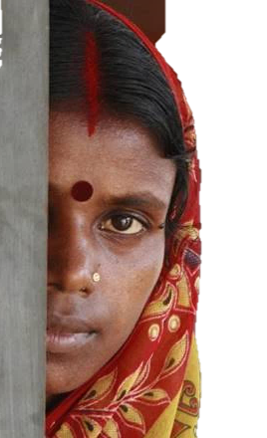
Women
CURRENT ISSUES
SURRENDERING TO THEIR FAITH
SAFETY – SECURITY ISSUES
LACK OF KNOWLEDGE
LEGAL PROCESS COMPLEXITIES

Slide 5

OUR SOLUTION
DASHBOARD FOR NGOs
IVR SYSTEM
WITH VOICEMAIL
RAISED ISSUES
ORGANISATIONS
UPLOAD PHOTO FACILITY

Slide 6




WHY US ?
WHOM TO HELP??
NEEDY
BRIDGE THE GAP
EASE OF USE
NO INTERNET REQUIRED
ONE STOP SOLUTION

Slide 7

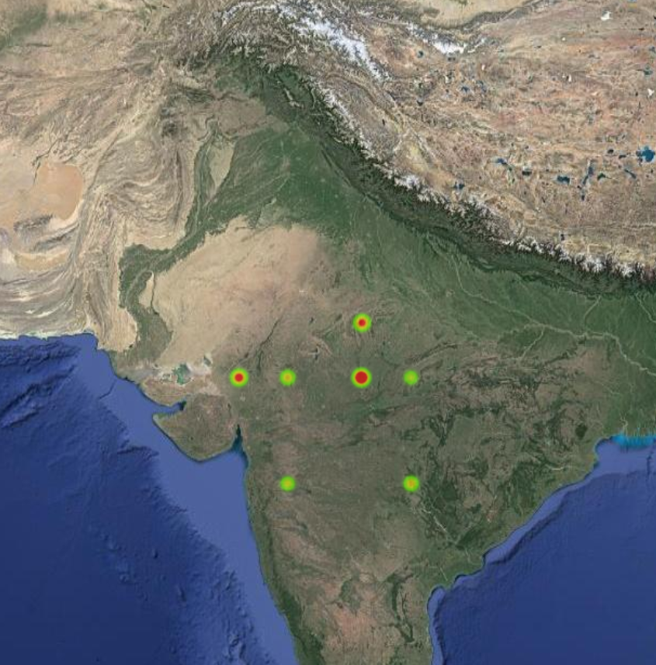
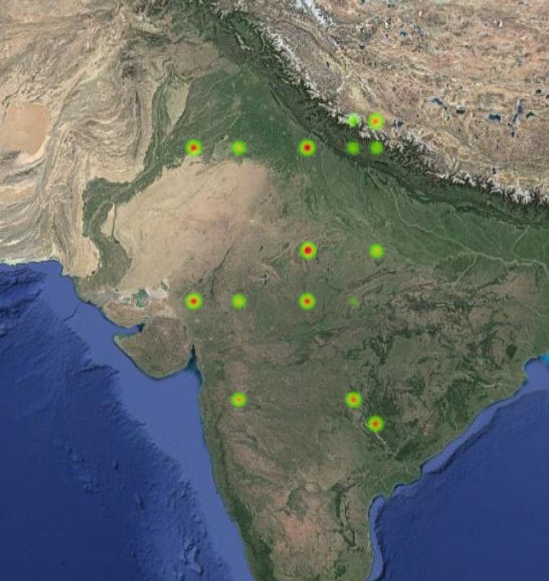
BENEFITS
AWAAZ
Sacche Hausle ki Pehchan…

Slide 8
FUTURE SCOPE
HELPING NGOs TO COLLABORATE
ONE-TO-ONE REACH ON SPECIAL REQUEST
PROGRESS STATUS OF THE VOICE RAISED

Slide 9
